Slide 1
Churners PROJECT PROPOSAL
Here is where our presentation begins
ميم سين

Slide 2
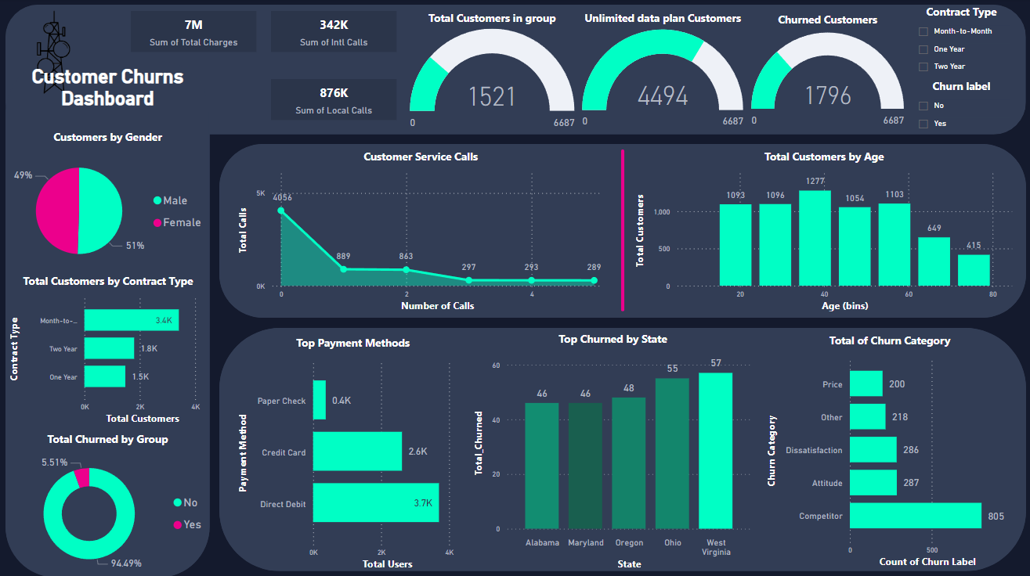
ميم سين

Slide 3
6,687
4,789
-26.0%
Total Customers at the Beginning of the Moth
Total Customers at the end of the Moth
of the total Customers!
ميم سين

Slide 4
Customers Calls
875824 322
341691 130
Total Local Calls & AVG Minutes
Total International Calls & AVG Minutes
133260
Churners Local Calls
You lost an 18.5%
Of the total Local Customer calls!
And 15.22% From international calls!
63438
Churners Int Calls
ميم سين

Slide 5
Customers Calls
ميم سين

Slide 6
Churned Customers And International Calls
35%
of the total Churned Customers are internationally active
ميم سين

Slide 7
Churned Customers And International Calls
49% of churners are Int active
ميم سين

Slide 8
Churned Customers And International Calls
Only 4% of Churners are Int Active and have Int Plan
ميم سين

Slide 9
Churned By Gender
Gender Does not affect The Churning
ميم سين

Slide 10
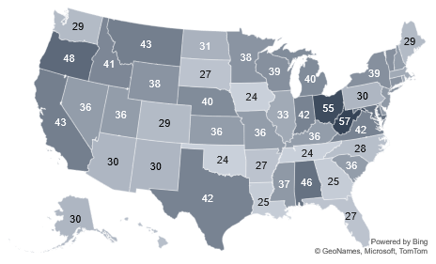
Churners By State
ميم سين

Slide 11
Churners By State
West Virginia, Ohio, and Alabama only are the common
ميم سين

Slide 12
Churners By Service Calls
Service calls Does it affect The Churning
ميم سين

Slide 13
Churners By Service Calls
Count of Customer Service Calls | Churner Percentage
0 | 9%
1 | 31%
2 | 37%
3 | 88%
4 | 100%
5 | 100%
After two customer calls there is a high percentage of a churn-out operation
ميم سين

Slide 14
Churners By Service Calls
55% of Churners Used the Direct Debit Method
ميم سين

Slide 15
Churners By Service Calls
About 70% of 3-5 Customer calls From Customers use Direct Debit
ميم سين

Slide 16
Service Calls By State
West Virginia and Ohio are the top states for customer service calls
State | Churn Percent
CA | 63%
OH | 35%
PA | 33%
MD | 33%
NE | 33%
ميم سين

Slide 17
Churners customer by contract type
The majority of customers who churn have a month-to-month contract
ميم سين

Slide 18
Month-to-Month churners by Churn category
This chart emphasizes the need to address competitive offers, improve customer satisfaction, and possibly review pricing strategies to reduce churn among Month-to-Month contract holders.
ميم سين

Slide 19
Churned Status by Contract type
This chart highlights the importance of long-term contracts in reducing customer churn.
ميم سين

Slide 20
Churned customer by account length
A significant number of churners at the very beginning (account length close to 0) indicates many customers churn shortly after starting their accounts.
As the account length increases, the number of churners decreases significantly.
ميم سين

Slide 21
Churned By Groping
Grouping Does affect The Churning
ميم سين

Slide 22
Not Churned By Groping
significant majority (70.93%) of customers did not in group
To highlight areas for potential improvement in customer retention strategies.
ميم سين

Slide 23
Churners By Churn Category
the primary reason for customer churn is competitors, suggesting that the company needs to improve its competitive positioning.
Dissatisfaction and attitude-related issues are also notable reasons for churn, highlighting potential areas for service or customer experience improvement.
ميم سين

Slide 24
Churners By Unlimited Data Plan
ميم سين

Slide 25
Focus on High Churn States: Targeted Retention Programs: Implement targeted retention programs in states with high churn rates, such as West Virginia, Ohio, and Oregon. Localized Marketing: Tailor marketing campaigns and offers to address the specific needs and preferences of customers in these states.
Address Churn Causes: Competitor Analysis: A significant number of customers churn due to competitors. Conduct a detailed competitor analysis to understand their offerings and identify gaps in your services. Enhance Value Proposition: Improve the value proposition of your services by adding features or bundling services to make your offerings more attractive. Customer Feedback: Regularly gather and analyze customer feedback to address dissatisfaction, attitude issues, and other reasons for churn
ميم سين

Slide 26
Optimize Contract Types: Month-to-Month Contracts: Since a large number of customers are on month-to-month contracts, consider offering incentives to switch to longer-term contracts, which can improve customer retention. Loyalty Programs: Implement loyalty programs for customers with longer contract commitments to enhance satisfaction and reduce churn.
Improve Customer Service First Call Resolution: Analyze the reasons behind multiple customer service calls and focus on resolving issues during the first call. Training and empowering customer service representatives with better tools and knowledge can help achieve this. Proactive Support: Implement proactive support measures like reaching out to customers who have called multiple times or those who might face common issues before they decide to churn.
ميم سين

Slide 27
THANKS!
Please keep this slide for attribution.
ميم سين

